Slide 1


New project proposals / Roadmapping
Technical WG
2021-12-13

Slide 2
Agenda
https://docs.google.com/spreadsheets/d/1OJnvrfrNsbuUC98C_LajJcu1CQpr4yFH0Uq640tW4uM/
Introduction
How to capture strategic vision/roadmap for OpenHW | Jérôme Quevremont
Recap of technical feedback from survey - Duncan | Duncan Bees
New Project Suggestions - 10 minutes per topic - (subset of following based on availability) | Presenter | Status
Recap on Multicore interconnect - what have we done and where should we go | Jérôme Quevremont, Thales | Confirmed presentation
Tiny FPU & relationship to FPU/FPNEW | Joe Circello, NXP (+ETHZ) | Confirmed presentation
Suggested OpenHW roadmap/project for fault tolerant cores | Li Chen, U Sask | Confirmed presentation
CHERI protection model | Tariq Kurd, Huawei | Confirmed presentation
Out of order cores | John Davis, BSC | Confirmed presentation/ presented by Duncan on behalf of John
UVM Reference model, Register model and ISG | Dave Poulin, Datum | Replacecd with following presentation:
Advanced UVM Agent architecture and a v2 implementation of the OBI agent. | Dave Poulin, Datum | Apologies for not joining
Next steps on Chiplet | Fabien Clermidy, CEA | Confirmed presentation
How should OpenHW utilize QEMU simulator | Wei Wu, ISCAS | not yet confirmed
Suggested direction for core-v unified test bench /ISS | Simon Davidmann, Imperas | not yet confirmed
Wrapup
Next steps on integrating feedback and creating roadmap summary | Jérôme Quevremont

Slide 3
Capturing strategic vision/roadmap for OpenHW
Technical WG role:
Kick off and vote on new projects
Track TG progress
Technical WG areas for improvement:
Members get to know each other (expertise, technical plans…) to foster collaborations
Steer OpenHW roadmap beyond current projects
Actions taken
New members’ introduction
Surveying members’ suggestions for new projects → feed roadmap
After 2 years, it is timely to refresh and publish the OpenHW technical roadmap

Slide 4
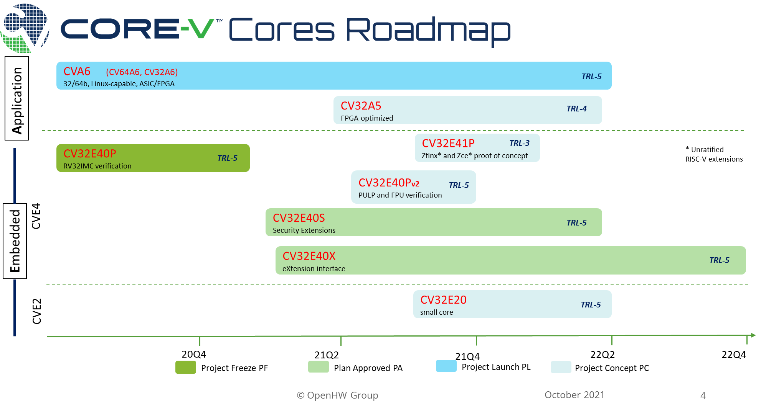
Roadmapping
Give directions beyond current projects
Extend to other TGs
Verification TG
SW TG
HW TG
Interconnect TG
Functional Safety TG
Prepare and publish a consolidated OpenHW roadmap by mid 2022
sets direction and plan of record
common look and feel
based on TG-level roadmap inputs and TWG member review

Slide 5
Next steps on OpenHW Roadmap
This meeting + 2nd TWG meeting to complete new project suggestions
TGs prepare a timeline map of projects and deliverables by end of March 2022. Include
Confirmed and potential projects
Collaborations between members and with external groups
Target TRL…
Consolidation of TG roadmaps (TG *chairs / TWG co-chairs / OpenHW staff)
Presentation by TWG co-chairs to TWG for review and ratification (end of June 2022)
Feedback on this process welcome.
Suggested roadmap term 3 years (e/o 2024)

Slide 6
Recap of technical feedback from survey
(Duncan)
Members’ survey summary slides
Suggestions grouped by topic: see agenda

Slide 7
Overall Survey Findings (1)
Finding | Specific Suggested Action
Generally OpenHW is well-run and effective
Key open-source benefit is supporting freedom of innovation via open-source IP | Continue on current path
SW business and project model need work. SW is viewed as crucial. Key SW projects such as compilers and tools, SDK and HAL need to move along. | SW “Tiger Team” from OpenHW Staff, TG leaders and interested members to identify specific issues around SW participation and business model and develop options for improvement
Generally need higher participation (by members) within projects | OpenHW Staff and project leaders can help promote and communicate on projects by increased collateral on website; spotlight projects-of-the-month; “how to get involved guide” for each project; raise awareness of contribution needs and opportunities per project.
Convey project information more effectively to enable members to quickly understand project status and goals | Transition to visual dashboard underway
Perception of processes | Increased crispness on key processes such as voting on project selection. Minimize process overhead where possible.
Mailing Lists | Build up effective mailing lists especially for TWG and MWG.

Slide 8
Overall Survey Findings (2)
Finding | Specific Suggested Action
Keep up recruiting momentum and attract additional industry participation by major companies | See MWG item.
MWG not as effective as other groups | MWG revamp is underway under new Director of Marketing including conferences, OpenHW TV, blogs, social media and other activities
Gap between research importance and effectiveness | Documentation for how to engage OpenHW Accelerate on website is underway with Mitacs.
New Project Suggestions | TWG should drive a review of the suggested new projects
Avoid fragmentation and focus on key projects | TWG needs to be opinionated in steering and reviewing the overall roadmap. Recruit TWG co-chair to help drive this.
Better/more consistent naming for projects | Action currently in place to document Part Number naming, and revise project naming.
Increase focus on CV-X-IF implementation in cores and drive this forward in standards | TWG & Cores TG should evaluate X-IF suitability for each core. Consider engagement with RISC-V International
Chiplet and interconnect interest | Interconnect projects such as Chiplet and many core heterogeneous coherent interconnect. Keep on TWG front burner
Increase focus on formal Verification | Open-source formal properties for key cores (take up in TWG and Verification TG)

Slide 9
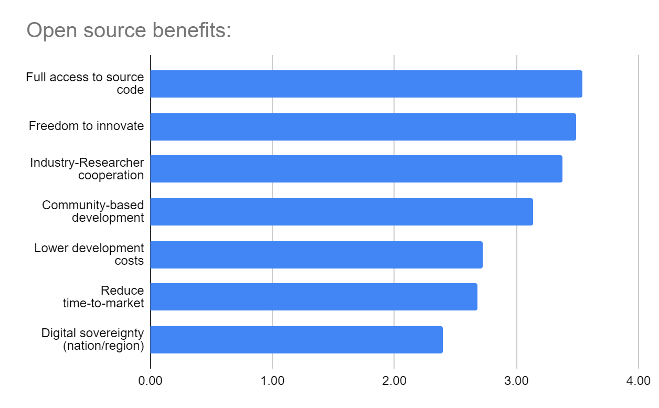
Importance of Open Source Benefits

Slide 10
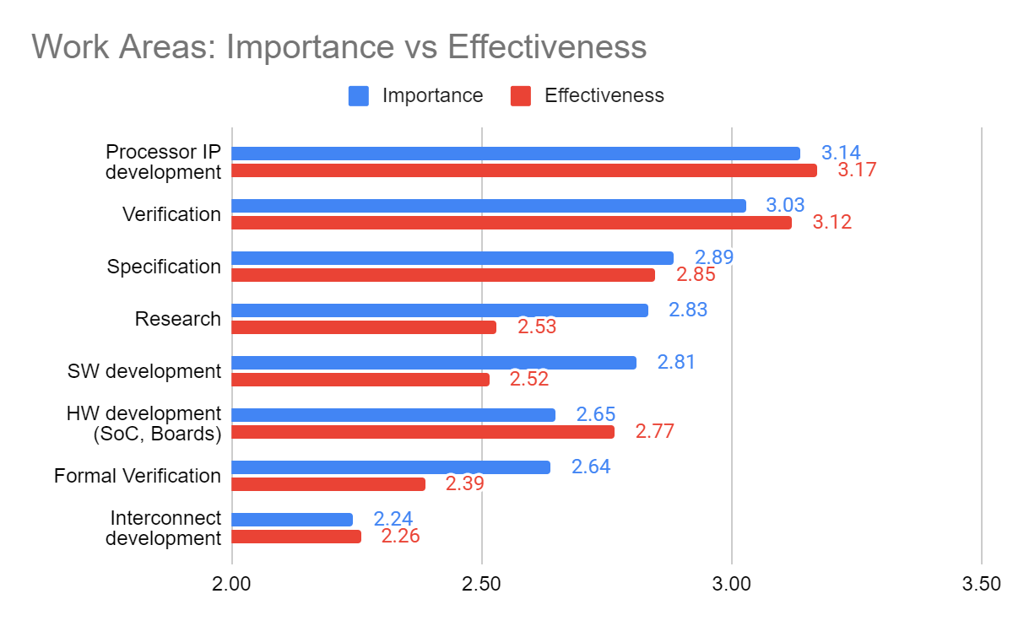

Slide 11
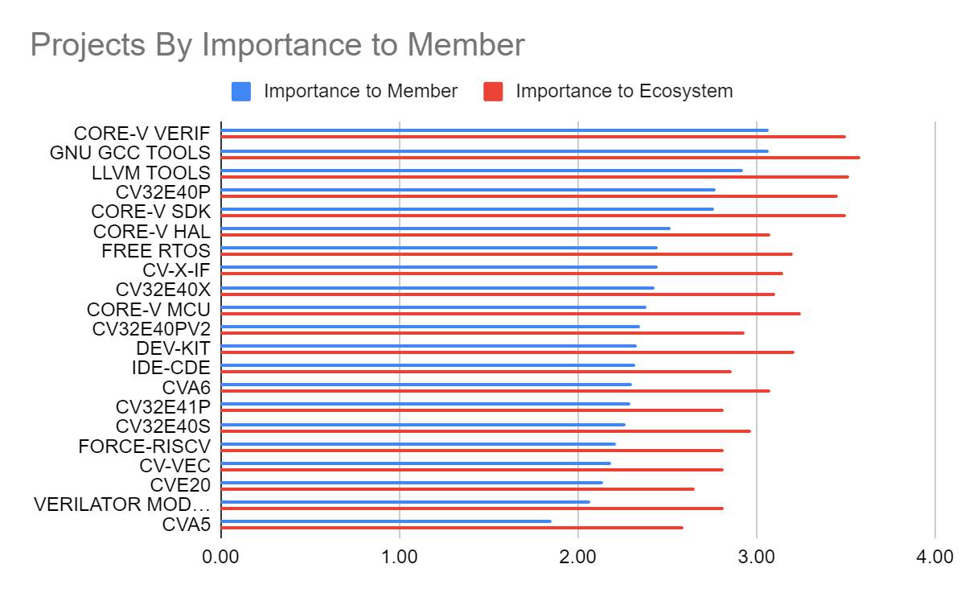

Slide 12
New Project Suggestions
10 minutes per topic (questions + discussions)

Slide 13
Presentations
CHERI protection model
Tariq Kurd, Huawei
Tiny FPU & relationship to FPU/FPNEW
Joe Circello, NXP (+ETHZ)
Next steps on chiplets
Denis Dutoit, CEA
Suggested OpenHW roadmap/project for fault tolerant cores
Li Chen, U Sask
Out of order cores
Short presentation by Duncan on behalf of John Davis, BSC
Recap on Multicore interconnect - what have we done and where should we go
Jérôme Quévremont, Thales (next slides)

Slide 14
Multicore interconnect
Recap on Multicore interconnect - what have we done and where should we go
Suggestions from survey | In OpenHW reach | Proposed roadmap | Targetted TGs
Multi/many core heterogeneous coherent interconnect | OpenPiton open-source manycore framework Demonstrations: OpenPiton + CV64A6 + Debian | Coherent support for other IPs (GPUs, NNs, coarse-grain coprocessors…) in OpenPiton | Interconnect TG
Predictible multi-core processor and interconnect for safety critical applications. | Predictable & High-Performance RISC-V Multicore Framework (McMaster’s presentation at 2021-11-22 TWG) | Fixed/bounded latency for timing-critical processes/tasks/applications. | Interconnect TG Functional Safety TG

Slide 15
Acceleration and SoC
Suggestions from survey | In OpenHW reach | Proposed roadmap | Targetted TGs
Kit to leverage CV-X-IF and easily develop an extension | CV-X-IF specification CV32E40X CVA6 | Step 1: “How to” guides: build the interface, the extension RTL, extend LLVM Reference design for a few extensions (e.g. bitmanip, domain specific…) Step 2: Turnkey solution to generate all artefacts from a high-level description | SW TG Cores TG
Set of standard peripherals to build a complete SoC, preferably open-source. Rather leverage existing external IP than starting from a blank slate. | ? | Address new RISC-V interrupt controllers (AIA…) TBD | ?

